Slide 1

Basic Computing Curriculum
Session 1: Introduction to Computing
Notes:
Hi everyone and welcome to our first basic computing session! Today we will get familiar with fundamental computing concepts and computer components.

Slide 2

Agenda
Introduction to Computing
Computer Basics
Office Applications
Practical and Review
Notes:
In today's agenda, we will teach you a small introduction to computing and learn about computer basics. Furthermore, we will see the basics components of Office applications and the teacher show you some hardware devices.

Slide 3
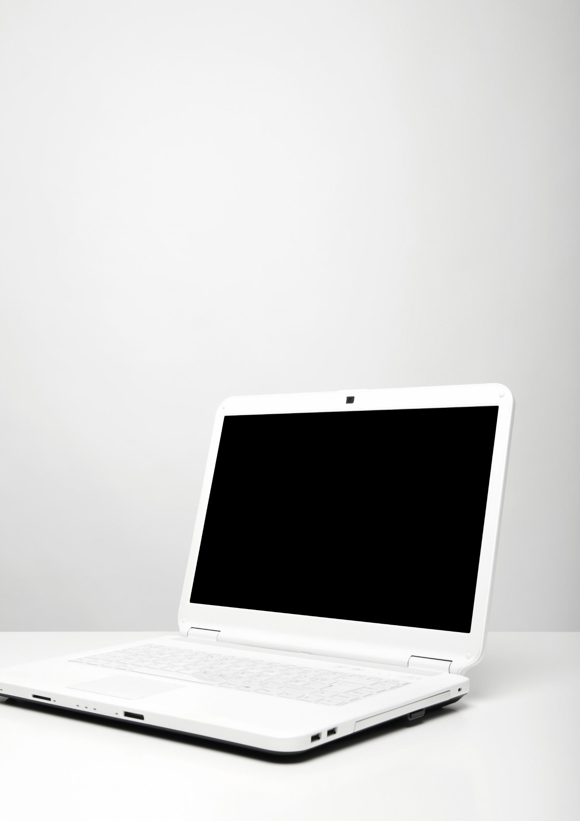
Introduction to Computing
Computing is the science of automating information processing using electronic devices and computer systems.
Computing involves operating and programming computers.
Computing is essential in modern society, with applications in almost every industry.
Notes:
Computing encompasses a wide range of technologies and practices, including hardware and software engineering, programming, data management, and security. It has become an integral part of modern society, with applications in almost every industry, from healthcare and finance to entertainment and social media. In this presentation, we will explore the basics of computing and its impact on our daily lives.

Slide 4
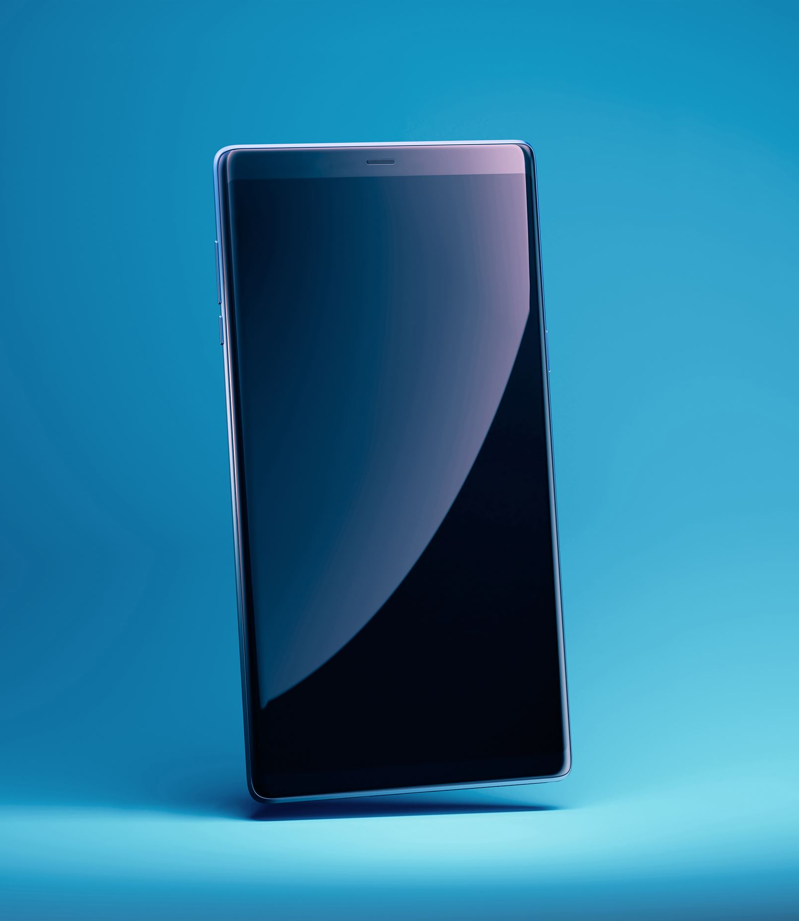
How We Use Computing in Our Daily Lives
Communications: Email, Social Networks
Entertainment: Video Games, Music, Movies
Education: Online Learning, Research
Work: Managing Projects, Using Office Software
Notes:
Computing is an integral part of our daily lives in the modern world. Communications, entertainment, education, and work all rely on electronic devices and computer systems. For example, we use email and social networks for communication, video games and music for entertainment, online learning and research for education, and office software for work. These devices and systems make our lives easier and more efficient.

Slide 5
Computer Basics

Slide 6
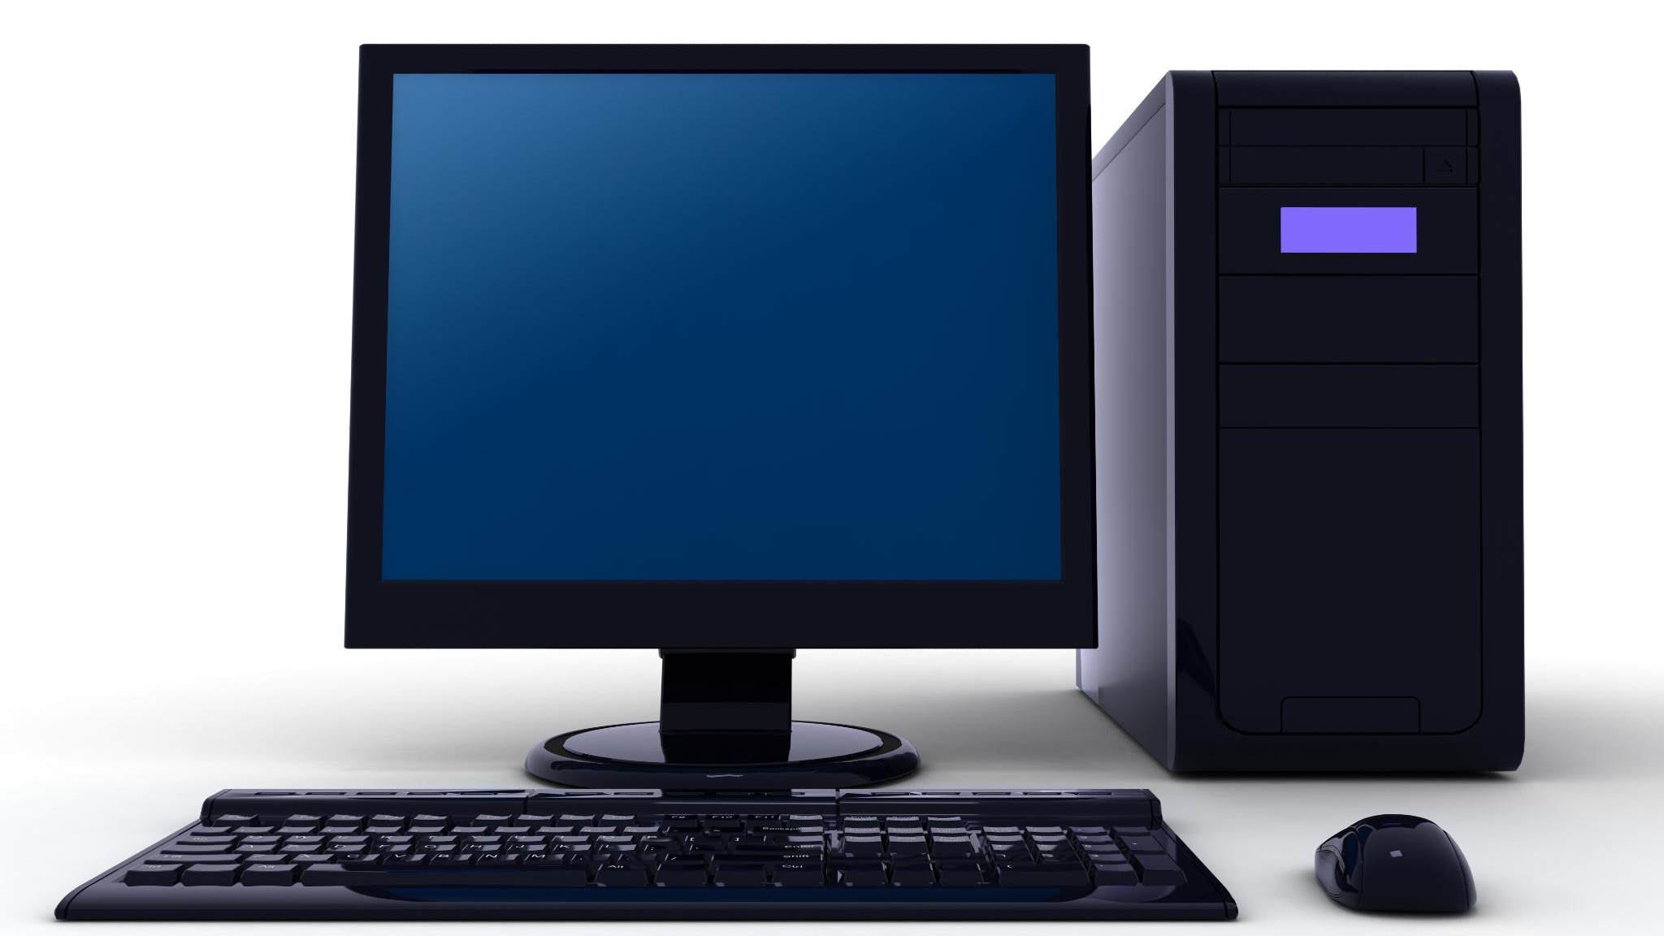
Computer Parts
Computers are essential tools in computing
Hardware and software are the two main categories of computer parts
Hardware includes components like CPU, Monitor, Keyboard, Mouse, and Hard Drive
Software includes Operating systems and Applications
Notes:
Computers consist of hardware and software. Hardware components include the CPU, Monitor, Keyboard, Mouse, and Hard Drive. Software components include Operating systems and Applications which enable the hardware to function. This slide provides an introduction to the various parts of the computer and their functions.

Slide 7

How to Turn On and Off Your Computer
To turn on your computer, press the power button located on the front or side of your computer.
To shut down your computer, click on the Start menu located in the bottom left corner of the screen, then click Shut down.
Notes:
Turning on and off your computer is a simple process. When you're ready to start using your computer, press the power button located on the front or side of your computer. When you're finished using your computer, you should always shut it down properly to avoid data loss or other issues. To shut down your computer, click on the Start menu located in the bottom left corner of the screen. Then, click Shut down. Your computer will safely shut down and turn off.

Slide 8
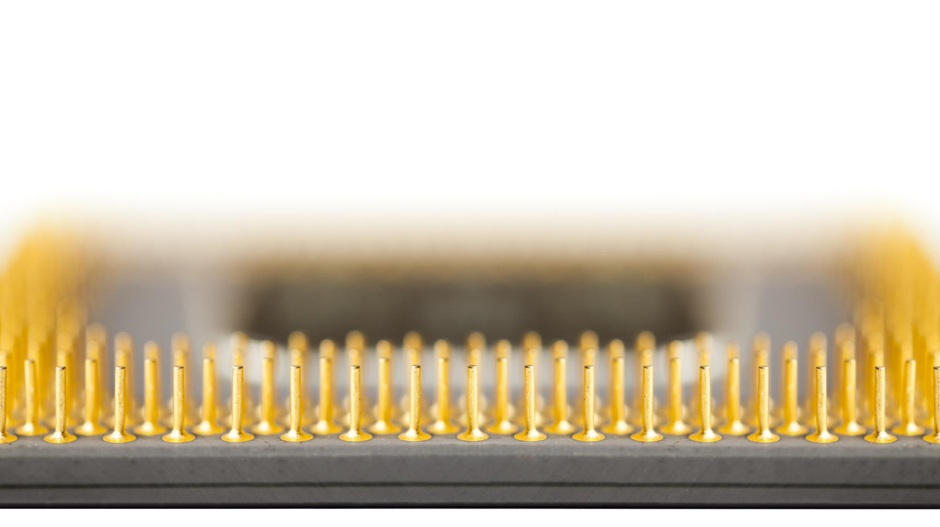
Mouse Basics
The mouse is an essential component in computing.
It allows the user to interact with the graphical interface of the computer.
The main components of the mouse are left button, right button, scroll wheel and some have additional buttons.
Notes:
The mouse is an essential tool in computing, and it is used to interact with graphical interfaces. It is composed of several parts, including the left and right buttons, a scroll wheel, and sometimes additional buttons. The left button is primarily used for selecting items on the screen, while the right button is used for opening context menus. The scroll wheel is used to scroll through documents or web pages, while additional buttons can be programmed for specific tasks.

Slide 9

Mouse Basics: Actions You Can Do with a Mouse
Left-click: Select an item or activate a command
Double-click: Open a file or program
Right-click: Open a command menu
Scroll: Navigate through documents or web pages
Drag and drop: Move or copy items by dragging with the mouse
Cursor movement: Move the cursor to different parts of the screen
Notes:
The mouse is an essential component of computing, allowing users to interact with the graphical interface of a computer. Left-clicking selects an item or activates a command. Double-clicking is used to open files or programs. Right-clicking opens a command menu. Scrolling is used to navigate through documents or web pages. Drag and drop is used to move or copy items by dragging with the mouse. Cursor movement moves the cursor to different parts of the screen.

Slide 10
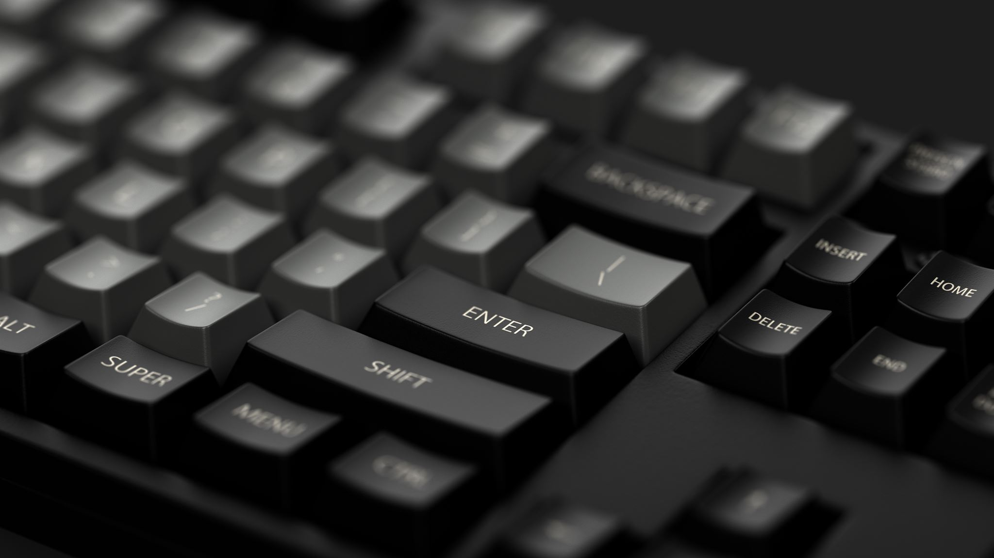
Parts of a keyboard and It’s uses
Type text using the alphanumeric keys
Use the special function keys for specific actions
Enter numeric data using the number pad
Use the arrow keys to navigate through documents
Use the control keys for shortcuts
Notes:
A keyboard is an important input device for a computer. It enables us to input text into word processors, emails, and web browsers. The alphanumeric keys include the letters and numbers, while the special function keys provide shortcut access to specific functions. The numeric keypad is usually located on the right-hand side of the keyboard and helps in quick numerical entry. The arrow keys, function keys, and control keys have special functions that vary depending on the program being used.

Slide 11
Office Applications

Slide 12

Introduction to Office Applications
Office applications are essential for work and productivity
They allow us to perform office tasks efficiently and in an organized manner
Notes:
Office applications are a suite of software programs that are designed to help us complete tasks related to our work. These applications can be used for a wide range of tasks, including writing documents, creating spreadsheets, and making presentations. The next slides will introduce you to the most commonly used types of office applications.

Slide 13
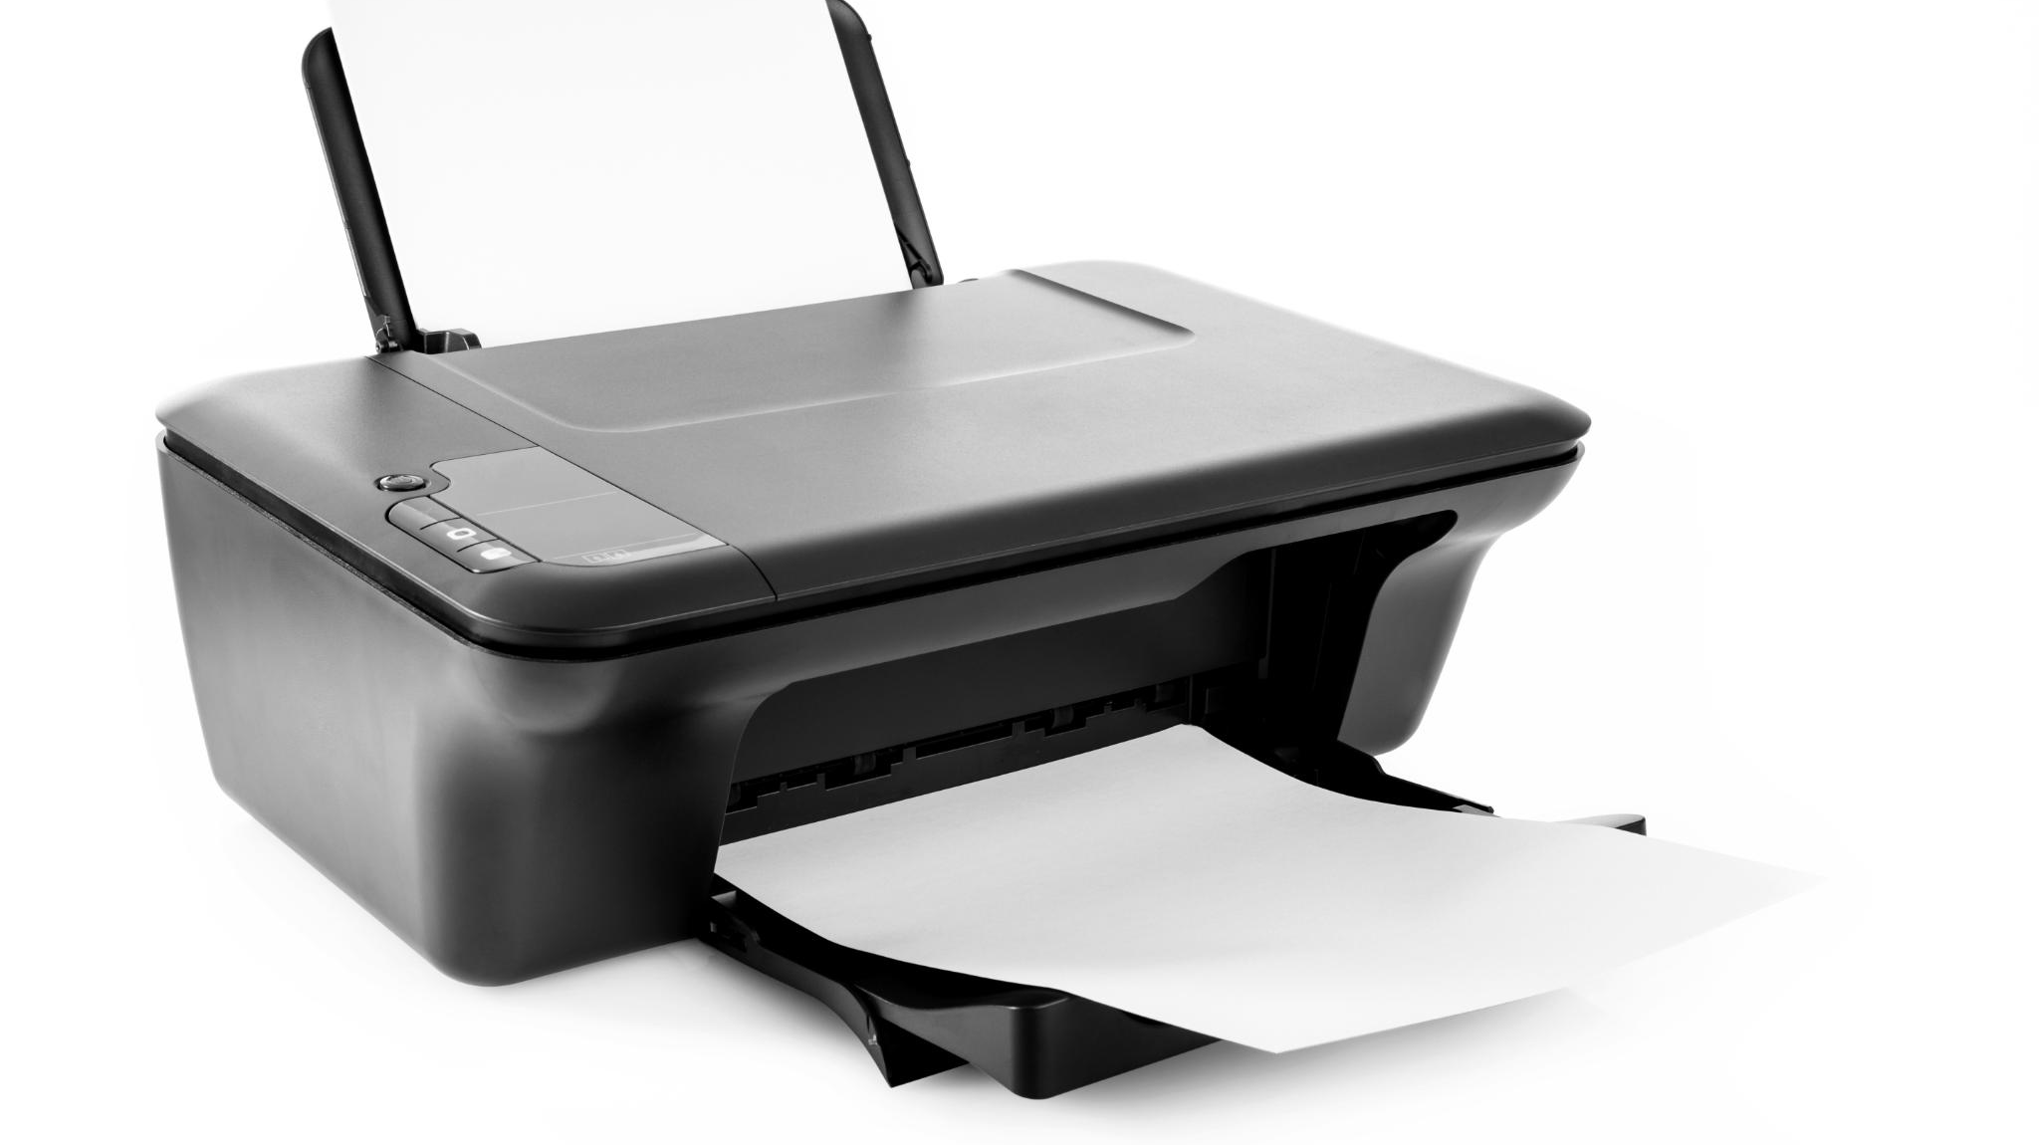
Word Processors
Word processors are used for writing and formatting documents
Microsoft Word and Google Docs are two popular word processing applications
Notes:
Word processors are software programs that are used to create, edit, and format text documents. They are commonly used in offices, schools, and homes. Some popular word processors include Microsoft Word, Google Docs, and Apple Pages. These applications allow you to create professional-looking documents, such as letters, reports, and resumes.

Slide 14

Spreadsheets
Spreadsheets are used for organizing data and performing calculations
Microsoft Excel and Google Sheets are two popular spreadsheet applications
Notes:
Spreadsheets are software programs that are used to organize, analyze, and manipulate data. They are commonly used in business, finance, and research. Some popular spreadsheet applications include Microsoft Excel, Google Sheets, and Apple Numbers. These applications allow you to create tables, charts, and graphs that summarize and analyze data.

Slide 15
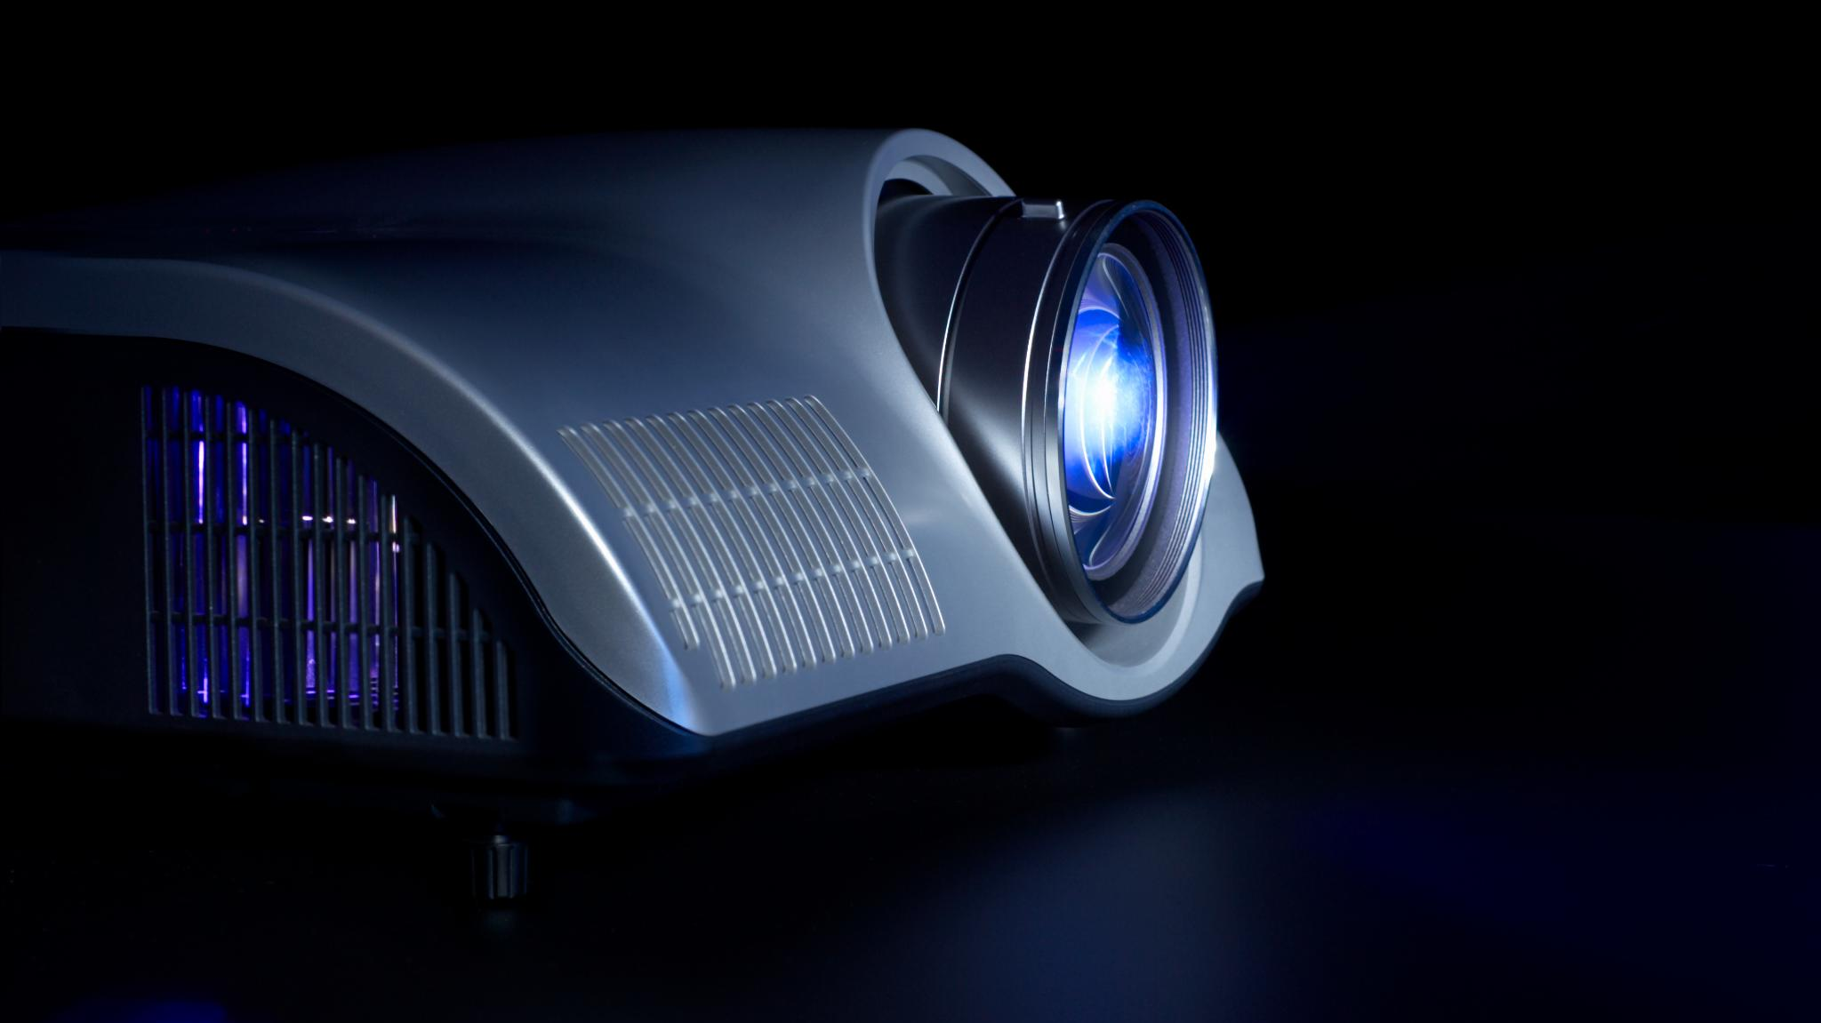
Presentations
Presentations are used for creating slides and presenting information
Microsoft PowerPoint and Google Slides are two popular presentation applications
Notes:
Presentation software is used to create visual aids for presentations. Some popular presentation applications include Microsoft PowerPoint, Google Slides, and Apple Keynote. These applications allow you to create slides that can include text, images, audio, and video. Presentations are commonly used in business, education, and training to communicate ideas and information to audiences.

Slide 16
Practical and Review

Slide 17

Time to Get Practical
Let's put what we've learned into practice
Engage in hands-on activities to reinforce learning
Experiment with new ideas and concepts
Notes:
This slide marks a transition from lecture-style learning to hands-on practice. Encourage your audience to take a more active role in their learning by setting up practical exercises. Remember to provide clear instructions and be available to answer any questions that may arise.

Slide 18

Review of What we learned
Computing is the automated processing of information.
Computing is used in almost every industry.
Hardware and software are the two main categories of computer parts.
Turning computers on and off requires specific steps.
The mouse and keyboard are essential components of computing.
Notes:
Today, we covered the basics of computing. We learned what computing is and its everyday use, the parts of a computer and how to properly turn it on and off, and how to use the mouse and keyboard. These core concepts will serve as a foundation as you continue to learn more about computing.

